Slide 1

CDAP | Project Proposal Presentation
AssembleMe
ARTIFICIAL INTELLIGENCE BASED PERSONAL COMPUTER PARTS ASSEMBLING ASSISTANT
Group : 19-069

Slide 2





OUR TEAM
Supervisor :
Prof. Koliya Pulasinghe
Team :
01
02
03
04
H.K.S.P. Gunadasa
Sewwandi E.D.D.
M.A.V.L. Gunathilaka
Tharaka K.K.S.
IT16010390
IT15146816
IT16055186
IT16054578

Slide 3
AGENDA
Introduction
Research Problem
Research Gap
Solution
High Level System Diagram
Assemble Personal Computer According to Game Requirement
Facebook Comments Analysis
Price Comparison and Optimization
Laptop Comparison
Work Breakdown Structure
Gantt Chart
References

Slide 4
INTRODUCTION
Globally Faced issue.
Affects different age gaps.
Both IT experts and Non – IT experts are affected.
Conventional methods are used. Namely,
Using Internet.(E.g. : websites, YouTube)
Inquire from experts.
Seller recommendations.

Slide 5
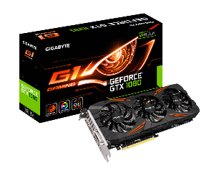

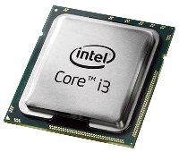
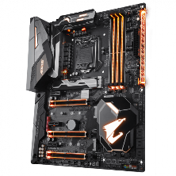
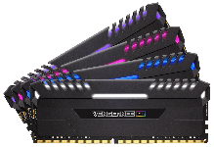
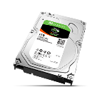




RESEARCH PROBLEM
How do I build a PC without having knowledge about Compatibility???
Difficulty in finding compatible PC parts.
Users have limited technical knowledge.
Difficult to find PC parts matching the Gaming requirements.
Limited sources to find best products for reasonable prices.
Necessity to view analyzed customer comments
Need to compare laptops and select the best one.
Image source : http://www.pngmart.com/image/87246

Slide 6

Our solution is based on below four research components.
Assemble PC according to game system requirements
Facebook Comment Analysis
Price Comparison & Optimization
Laptops Comparison
SOLUTION
Notes:
Our solution has four main sub research components
Helps User to identify compatible parts for gaming requirement
to get idea about product before purchasing
Compare local vendor price with global e commerce sites and choose the best price for a product
Compare computational power and choose the best one among them

Slide 7
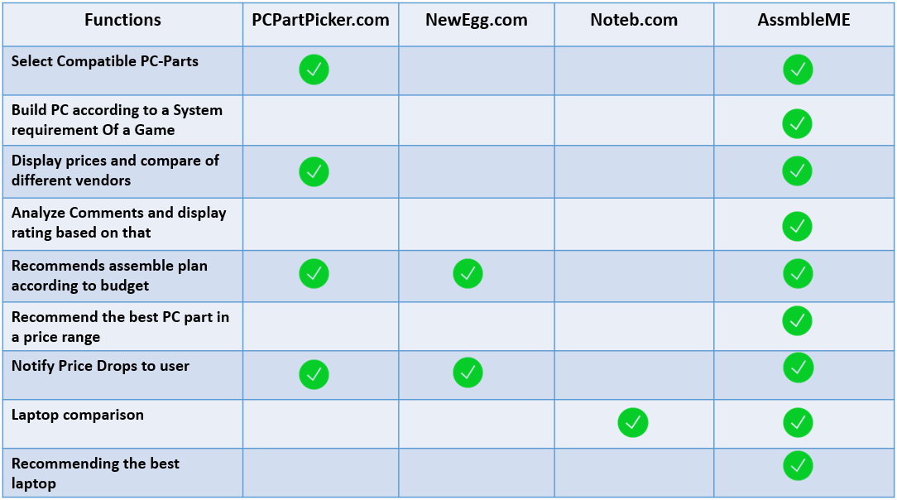
RESEARCH GAP

Slide 8
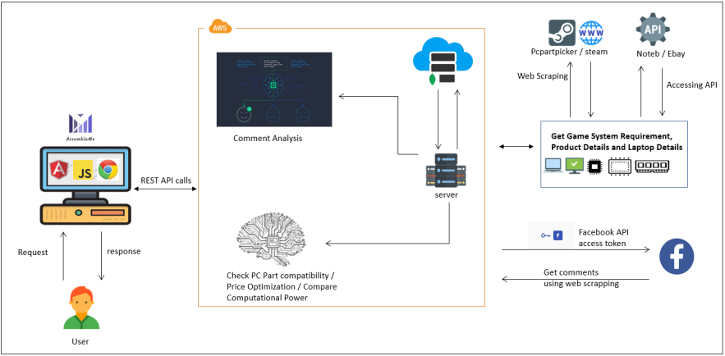
HIGH LEVEL SYSTEM DIAGRAM

Slide 9
ASSEMBLE PERSONAL COMPUTER
ACCORDING TO GAME SYSTEM REQUIREMENTS
H.K.S.P Gunadasa IT16010390
Notes:
Get Game system requirement by Web scraping
Match compatible parts with the requirement

Slide 10
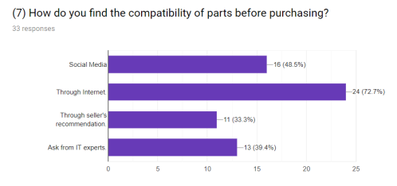
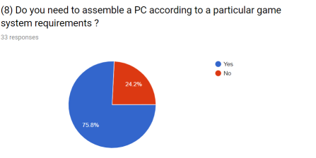
ASSEMBLE PC ACCORDING TO GAME
SYSTEM REQUIREMENTS
Specific Objectives
Identify and check compatibility of each computer parts
Ability to assemble a pc according to a game system requirement
User can ensure the game is working properly on their PC
IT16010390
Notes:
conducted a survey
most of them tend to assembling a PC
They need to assemble a PC for different requirements
But They Didn’t have knowledge to identify the parts that satisfy the requirement and compatibility

Slide 11
WORK BREAKDOWN
Get the system requirements of the selected game using web scraping (steam.com) and format real time
Develop custom build sequence by using expert system and decision tree algorithm
Using build sequence identify the compatibility of the parts which satisfy the requirement
The build sequence will analyze the final product (assembled PC) as several sub components and match those specifications.
IT16010390
Notes:
Use expert system and decision tree algorithm to build custom build sequence
Build sequence Is process to identify all the parts to build final product
a sequence help to identify compatibility and match features of parts
Final product is combination of several sub components
As Memory, Graphics, CPU and motherboard
Match features to select compatible items

Slide 12
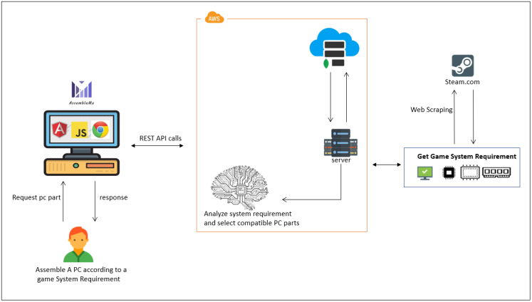
SUB-COMPONENT ARCHITECTURE
(Assemble PC)
IT16010390

Slide 13
FACEBOOK COMMENT ANALYSIS
Sewwandi E.D.D
IT15146816

Slide 14
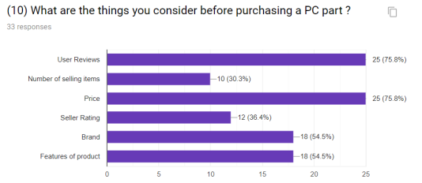
FACEBOOK COMMENT ANALYSIS
Specific Objectives
Users can get feedbacks before purchasing a product.
Byers can ensure the product quality.
Useful for a product comparison.
IT15146816

Slide 15
WORK BREAKDOWN
Get the required keyword from the search tags user has selected.
Track the social media comments related to the keyword tags.
Using a Facebook API (Graph API) Token comments will be accessed.
Web scraping is used to extract the comments Real Time.
Comments will undergo opinion mining procedure.
Determine the positivity or negativity of a comment
Display the analyzed customer review summary.
IT15146816

Slide 16
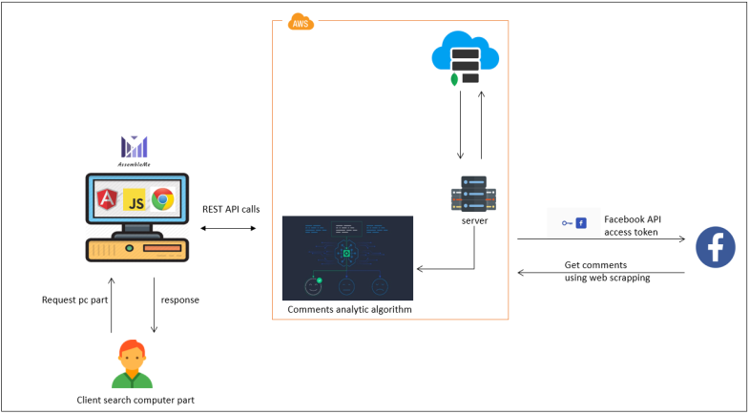
SUB-COMPONENT ARCHITECTURE
(Facebook Comments Analysis)
IT15146816

Slide 17
PRICE COMPARISON AND OPTIMIZATION
M.A.V.L Gunathilaka
IT16055186

Slide 18
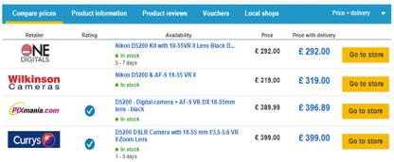
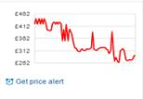
PRICE COMPARISON AND OPTIMIZATION
Specific Objectives
Ability to search different products of different vendors in the
same place and the same time.
Suggest the best PC part in a given price range.
Suggest PC parts and where customers can purchase them to assemble
a PC for the optimum budget plan.
Notify the price drops to customers, if the price of the
product meets the customer budget.
Image source : https://www.google.com/search?q=price+comparison
IT16055186
Notes:
People have to go through each and every vendors’ website to compare product prices. We bring all in to one place.
People can change the price ranges so that system suggests the pc parts for the lowest budget.
Processor, RAM, VGA and Motherboard have the priority.
Most of the time cheapest product is not the best product.
System suggests the best product in that price range.
considering product features, prices and customer feedbacks.
Notify price drops.

Slide 19



WORK BREAKDOWN
The process of extracting data
Ebay, Amazon and Ali Express are the e-commerce websites.
Web scraping and their web APIs are used.
Local vendors can manage their user account to update products.
Product features, customer feedbacks, prices and number
of selling items are considered.
Develop an algorithm to recommend PC parts for the lowest
budget.
IT16055186

Slide 20
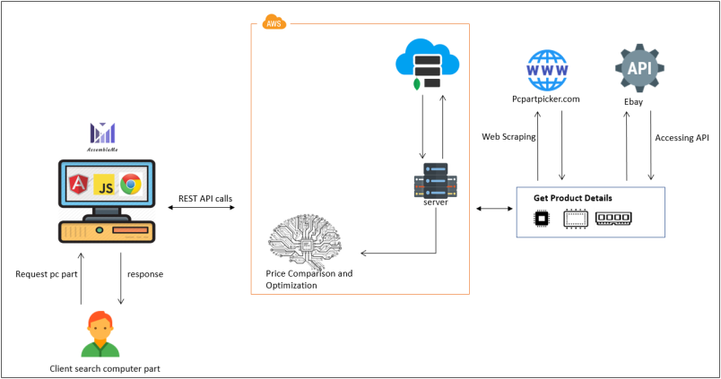
SUB-COMPONENT ARCHITECTURE
(Price Comparison & Optimization)
IT16055186

Slide 21
LAPTOP COMPARISON
Tharaka K.K.S
IT16054578

Slide 22
LAPTOP COMPARISON
Specific Objectives
Before Purchasing a laptop user can compare computational power
By comparing suggest the best laptop
Ability to compare and choose best laptop for non-technicians
Notes:
Apart from desktop computer, the laptops paly major role in the industry.
In the market there are lot of laptops brands available and each brand has different model.

Slide 23
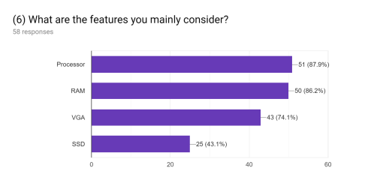
Survey Results
Survey findings on what are the things user consider when buying a laptop
IT16054578

Slide 24
WORK BREAKDOWN
Process of getting data
Get laptops details from noteb API
Format that data and store in the database
Develop artificial intelligence expert system to compare and recommend best laptop and suggest
Develop user friendly interfaces
IT16054578
Notes:
In this slide I will explain how this work flow happen

Slide 25
WORK BREAKDOWN (CONTD.)
When comparing two laptops mainly consider
Processor
Random Access Memory (RAM)
Hard Disk Drive
Graphics Processing Unit (GPU)
Battery Life
Best Laptop } Processor | RAM | Hard Driver | GPU| Battery Life
IT16054578
Notes:
Processor mainly 2 manufactures Intel and AMD , Intel processors more advanced than AMD one.
Recommended size of ram is 4GB , But you running application has more speed RAM size must more than 4GB (DDR4 , DDR3)
if you want system to perform the task , then you can use SOLID STATE DRIVE (SSD)
If user is game lover or want or watch Full HD & HD videos GPU is important

Slide 26
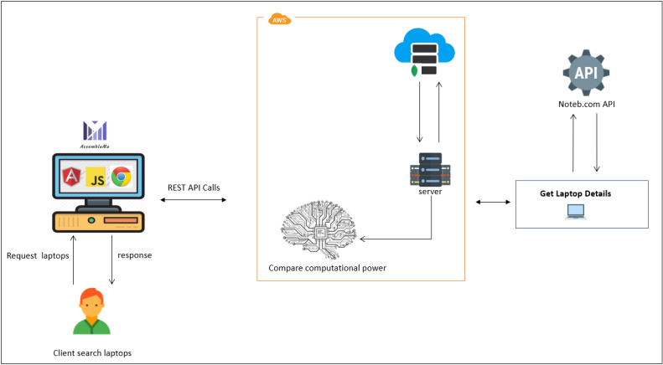
SUB-COMPONENT ARCHITECTURE
(Laptops Comparison )
IT16054578
Notes:
This is the high level diagram of laptop comparison
This is the API I previously mention.

Slide 27





USED TECHNOLOGIES
Technologies
Python 3.7.1
Java (spring boot framework)
Angular 6
NodeJS
Tools
Jupyter Notebook
Robo 3T
Microsoft Visual Studio Code
Spring Tool Suite
Database
MongoDB 4.0.0

Slide 28
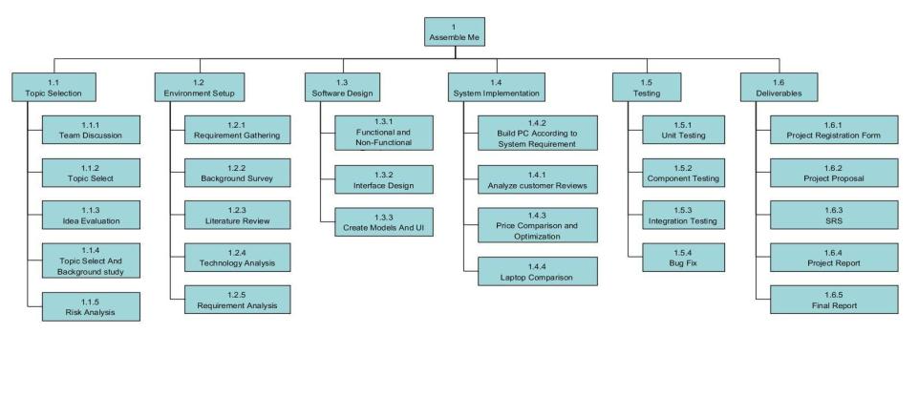
WORK BREAKDOWN STRUCTURE

Slide 29
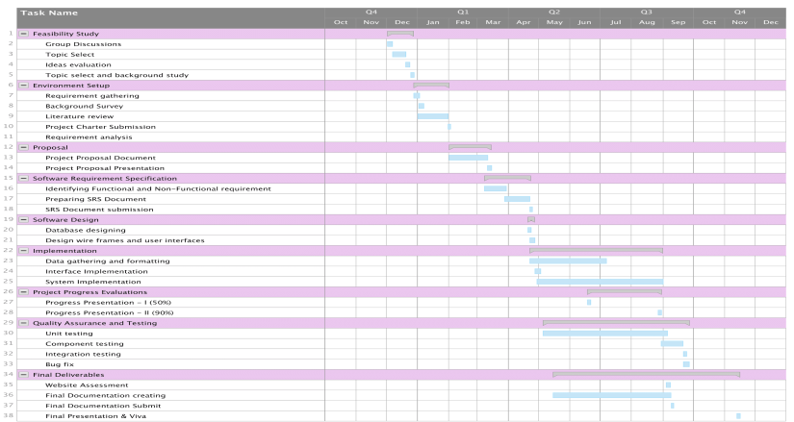
GANTT CHART

Slide 30
REFERENCES
F. N. Leo Rizky Julian, "THE USE OF WEB SCRAPING IN COMPUTER PARTS AND ASSEMBLY PRICE COMPARISON," 2015.
N. D. Udi Boker, "Comparing Computaional Power," 2015.
C. Kocas, "Online price competition within and between Heterogeneous Retailer Groups," 2004.
A. Salinca, "Business reviews classification using sentiment analysis.," 2016.
Y. N. A. O. I. O. BabolaT. Issac, "Assemblin a Desktop Computer System with In-Bult Uninterrupted Power Supply.," 2017.

Slide 31

T H A N K YOU

